Slide 1
Bilkent University EEE 473-573 Medical Imaging Final Project Presentation
Can Bayar
Ayhan Okuyan

Slide 2
Simulation Steps
K-Space Acquisition
Image Reconstruction
Slice Selection

Slide 3
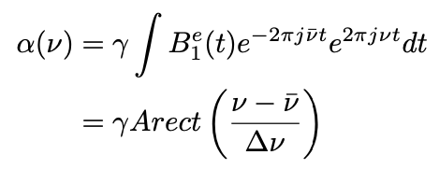

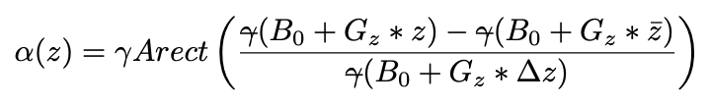
Slice Selection

Slide 4
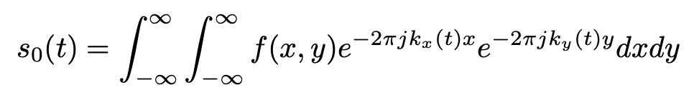
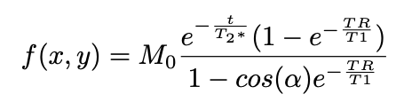

K-Space Acquisition

Slide 5
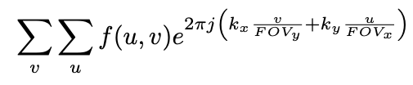

Reconstruction

Slide 6
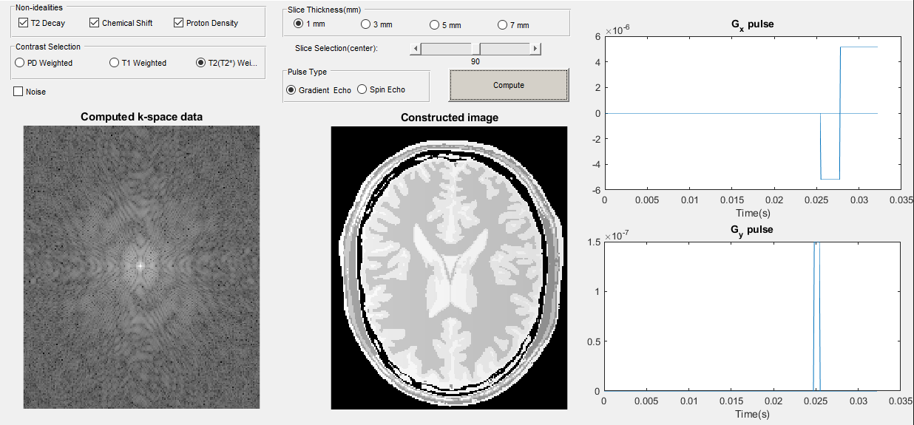
GUI Implementation
Figure 1: MRI simulator GUI showing different parameter options.

Slide 7
Non-idealities
Variational B0 Field
T2 Decay
Chemical Shift
Proton Density

Slide 8
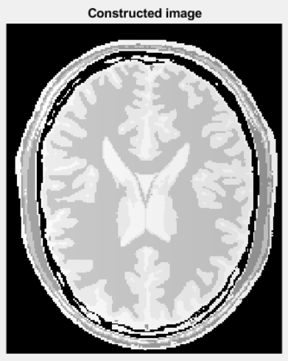
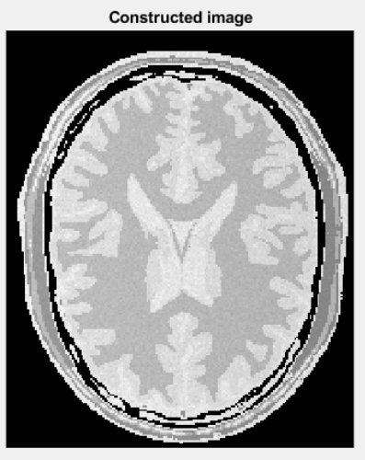
Figure 2: Effect of Spatially Varying Noise on B0

Slide 9
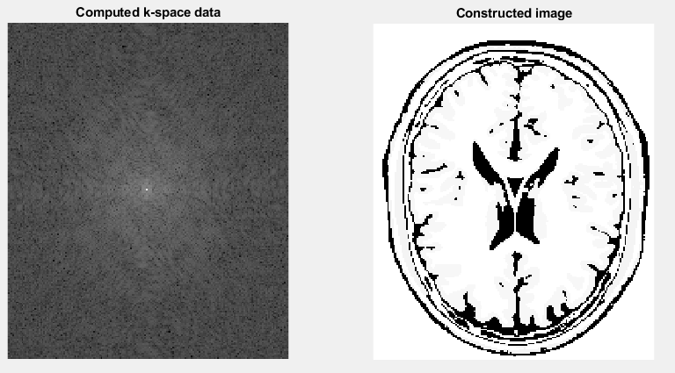
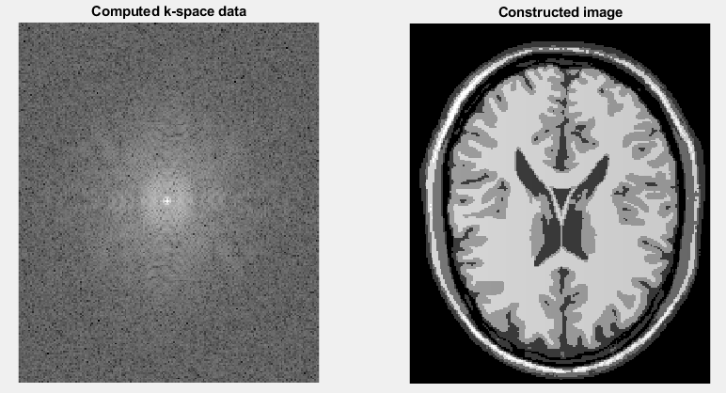
Figure 3: Image with and without T2 Decay

Slide 10
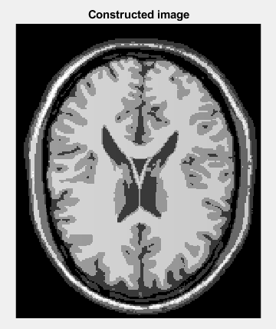
Figure 4: Image without and with chemical shift

Slide 11
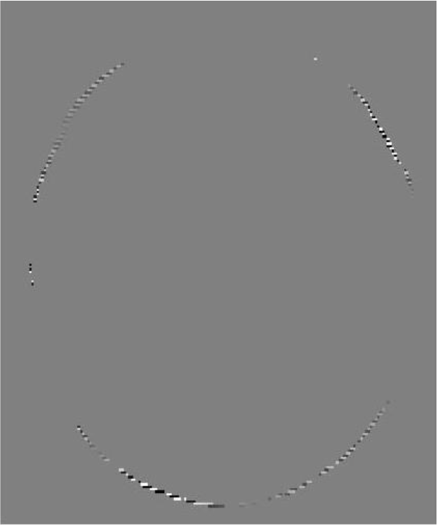
Figure 5: Difference of the images in Figure 4

Slide 12
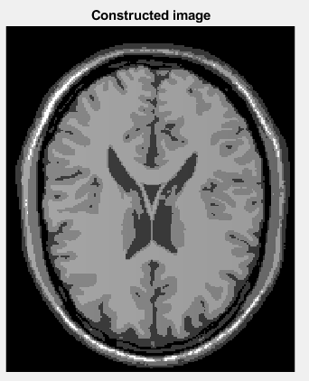
Figure 6: Image without and with proton decay

Slide 13
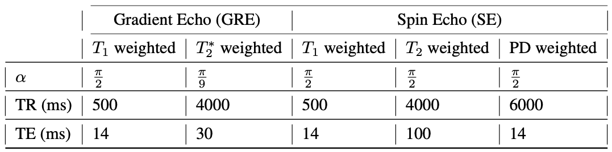
Contrast Mechanisms

Slide 14
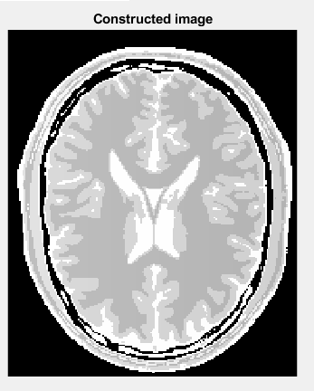
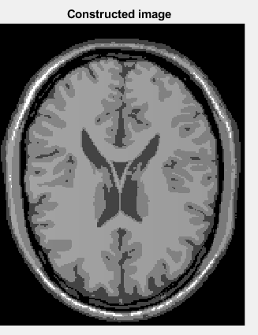
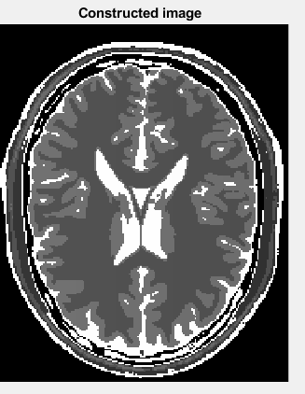
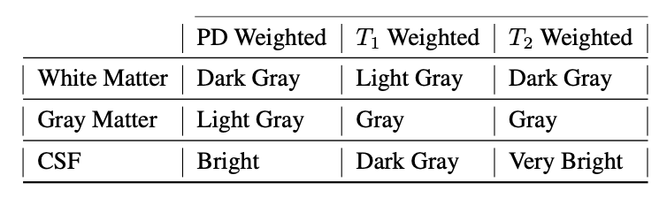

Slide 15
